Slide 1


Neural Network Foundations
17
PART IV · DEEP LEARNING AND MODERN AI
CHAPTER 17 · WEEK 11
Data Science — From Foundations to Intelligent Systems
LECTURER
Dr. Mustafa Hameed
THE ISLAMIA UNIVERSITY OF BAHAWALPUR
Bahawalpur, Pakistan
Department of Information Technology · BSIT · Fall 2026
Notes:
Chapter 17: Neural Network Foundations. Part 4 — Deep Learning and Modern AI. Week 11: Neural networks and architectures. Handout pages 109–114.

Slide 2

Where this chapter sits
THE COURSE
PART I
PART II
PART III
PART IV
PART V
PART VI
1
2
3
4
5
6
7
8
9
10
11
12
13
14
15
16
17
18
19
20
21
22
23
24
25
26
27
28
29
30
31
32
Neural Network Foundations
BUILDS ON
USED LATER IN
Ch 4 The Mathematical Toolkit
Ch 18 Deep Architectures
Ch 11 Machine Learning Fundamentals
Ch 12 Supervised Learning I: Regression
Data Science · Chapter 17 · Neural Network Foundations
Handout p. 109 2
Notes:
Place the chapter. Before you start: Chapter 4 (gradients, gradient descent, learning rate — this chapter is that machinery applied at scale), Chapter 12 (loss functions) and Chapter 11 (overfitting).

Slide 3

What you will be able to do
LEARNING OUTCOMES
By the end of this chapter you will be able to:
1
Compute the output of a single neuron by hand.
2
Describe the forward pass, loss computation, backpropagation and weight update as one training cycle.
3
Choose an activation function and explain why non-linearity is essential.
4
Diagnose a training run from its loss curves.
5
Decide whether a problem calls for a neural network at all.
Data Science · Chapter 17 · Neural Network Foundations
Handout p. 109 3
Notes:
Read these out: they are the chapter's contract with the room. Each click adds one.

Slide 4

Vocabulary for this chapter
KEY TERMS
neuron
weight
bias
activation function
ReLU
sigmoid
softmax
hidden layer
forward pass
loss
backpropagation
epoch
batch
optimiser
vanishing gradient
dropout
early stopping
Each term is defined where it first matters — not here.
Data Science · Chapter 17 · Neural Network Foundations
Handout p. 109 4
Notes:
Do not define these now; they arrive one at a time. This slide is for the students' notes. Terms: neuron; weight; bias; activation function; ReLU; sigmoid; softmax; hidden layer; forward pass; loss; backpropagation; epoch; batch; optimiser; vanishing gradient; dropout; early stopping.

Slide 5

In this chapter
IN THIS CHAPTER
17.1
One Neuron
p. 109 ›
17.2
Why Non-Linearity Is Not Optional
p. 110 ›
17.3
Layers and the Forward Pass
p. 111 ›
17.4
Training: The Four-Step Cycle
p. 111 ›
17.5
Reading a Training Curve
p. 112 ›
Data Science · Chapter 17 · Neural Network Foundations
Handout pp. 109–114 5
Notes:
The route through the chapter. Each row is a link: click it to jump to that section in the slide show.

Slide 6
One Neuron
SECTION 1 OF 5
17.1
17.1 One Neuron
17.2 Why Non-Linearity Is Not Optional
17.3 Layers and the Forward Pass
17.4 Training: The Four-Step Cycle
17.5 Reading a Training Curve
Data Science · Chapter 17
Handout §17.1 6
Notes:
Pause. Name the question this section answers.

Slide 7


Artificial Neuron
DEFINITION
A neuron computes a weighted sum of its inputs, adds a bias, and passes the result through an activation function:
The weights w_{j} and bias b are learned; the activation f is chosen by you.
Data Science · Chapter 17 · Neural Network Foundations
§17.1 · Handout p. 109 7
Notes:
Read the box aloud, then ask for an example from the room before moving on.

Slide 8
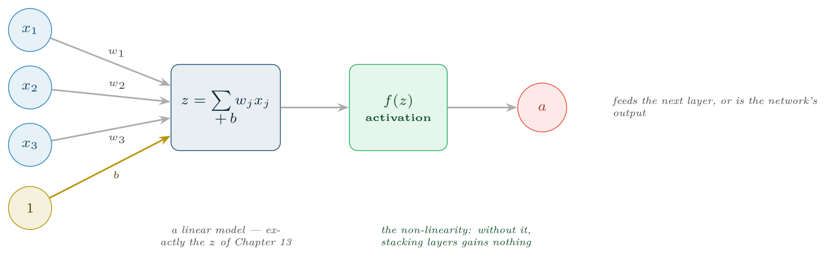
A single neuron
FIGURE 17.1
The summation is a linear model; the activation is what makes depth worthwhile. A neuron with a sigmoid activation is logistic regression (Chapter 13).
Data Science · Chapter 17 · Neural Network Foundations
§17.1 · Handout p. 109 8
Notes:
Figure 17.1 (handout p. 110): A single neuron. The summation is a linear model; the activation is what makes depth worthwhile. A neuron with a sigmoid activation is logistic regression (Chapter 13).

Slide 9

One Neuron, by Hand
WORKED EXAMPLE
Inputs x = [0.8, 0.3, 0.5] (scaled attendance, quizzes, forum activity), weights w = [1.2, −0.5, 0.9], bias b = −0.4, activation ReLU.
Weighted sum:
ReLU: a = max(0, 0.86) = 0.86. The neuron fires.
Now change the input to x = [0.2, 0.9, 0.1]:
The neuron is silent. This on/off behaviour is what lets a layer of neurons carve the input space into regions — and it is why ReLU produces sparse activations, with most neurons quiet for any given input.
Data Science · Chapter 17 · Neural Network Foundations
§17.1 · Handout p. 109 9
Notes:
Each click adds one step of the working. Ask for the next number before you reveal it.

Slide 10
Why Non-Linearity Is Not Optional
SECTION 2 OF 5
17.2
17.1 One Neuron
17.2 Why Non-Linearity Is Not Optional
17.3 Layers and the Forward Pass
17.4 Training: The Four-Step Cycle
17.5 Reading a Training Curve
Data Science · Chapter 17
Handout §17.2 10
Notes:
Pause. Name the question this section answers.

Slide 11

The Collapse Argument
WATCH OUT
Stack two linear layers: y = W₂(W₁ x) = (W₂ W₁)x = W x. The product of two matrices is a matrix, so a hundred stacked linear layers compute exactly what one linear layer computes. Without a non-linear activation between layers, depth buys literally nothing. This single fact is why activation functions exist.
Data Science · Chapter 17 · Neural Network Foundations
§17.2 · Handout p. 110 11
Notes:
Read the box aloud, then ask for an example from the room before moving on.

Slide 12
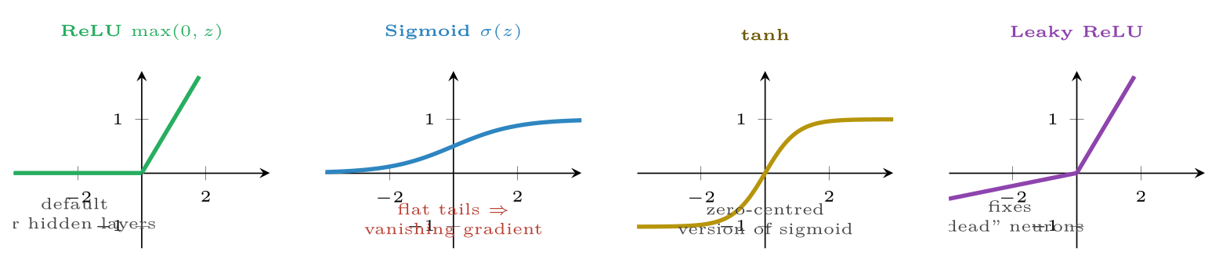
Four activation functions
FIGURE 17.2
ReLU is the default for hidden layers because it is cheap and its gradient does not vanish for positive inputs; sigmoid and tanh saturate, which stalls learning in deep networks.
Data Science · Chapter 17 · Neural Network Foundations
§17.2 · Handout p. 110 12
Notes:
Figure 17.2 (handout p. 110): Four activation functions. ReLU is the default for hidden layers because it is cheap and its gradient does not vanish for positive inputs; sigmoid and tanh saturate, which stalls learning in deep networks.

Slide 13

Why Non-Linearity Is Not Optional
AT A GLANCE
Activation | Where | Why
ReLU | Hidden layers (the default) | Cheap; gradient is 1 for z>0, so it does not vanish
Leaky ReLU | Hidden layers, if neurons die | Small negative slope keeps a gradient alive below zero
Sigmoid | Output only, binary classification | Produces a probability in (0,1)
Softmax | Output only, multi-class | Produces probabilities across k classes summing to 1
None (linear) | Output only, regression | The prediction is an unbounded number
Data Science · Chapter 17 · Neural Network Foundations
§17.2 · Handout p. 110 13
Notes:
Do not read the table row by row: pick the row the room is most likely to get wrong and ask why.

Slide 14
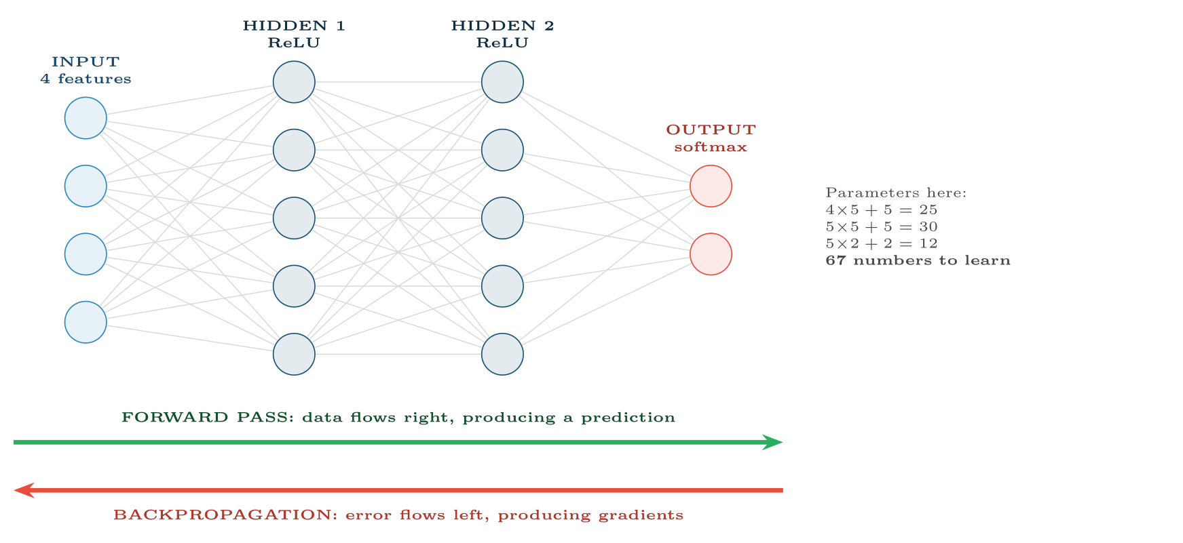
A small feed-forward network
FIGURE 17.3
Data moves right to produce a prediction; error moves left to produce the gradient for every weight. Both directions run on every training batch.
Data Science · Chapter 17 · Neural Network Foundations
§17.3 · Handout p. 111 14
Notes:
Figure 17.3 (handout p. 111): A small feed-forward network. Data moves right to produce a prediction; error moves left to produce the gradient for every weight. Both directions run on every training batch.

Slide 15
Training: The Four-Step Cycle
SECTION 4 OF 5
17.4
17.1 One Neuron
17.2 Why Non-Linearity Is Not Optional
17.3 Layers and the Forward Pass
17.4 Training: The Four-Step Cycle
17.5 Reading a Training Curve
Data Science · Chapter 17
Handout §17.4 15
Notes:
Pause. Name the question this section answers.

Slide 16
The Training Cycle
DEFINITION
1. Forward pass: push a batch through the network to get predictions.
2. Loss: measure how wrong they are (cross-entropy for classification, MSE for regression).
3. Backpropagation: apply the chain rule backwards to get ∂ L / ∂ w for every weight.
4. Update: w ← w − α ∇ L — exactly the gradient descent of Chapter 4.
Repeat for every batch; one pass over the whole dataset is an epoch.
Data Science · Chapter 17 · Neural Network Foundations
§17.4 · Handout p. 111 16
Notes:
Read the box aloud, then ask for an example from the room before moving on.

Slide 17

Backpropagation in One Sentence
CONCEPT
Backpropagation is the chain rule from calculus, applied efficiently: it computes how much each weight contributed to the final error by working backwards from the output, reusing the partial results at each layer instead of recomputing them. That efficiency is the entire reason deep networks are trainable at all.
Data Science · Chapter 17 · Neural Network Foundations
§17.4 · Handout p. 111 17
Notes:
Read the box aloud, then ask for an example from the room before moving on.

Slide 18
Training: The Four-Step Cycle
AT A GLANCE
Hyperparameter | Typical value | Effect if wrong
Learning rate α | 0.001 (Adam) | The one that matters most. Too high diverges, too low crawls (Figure 4.3)
Batch size | 32–256 | Small = noisy but often generalises better; large = faster per epoch, needs more memory
Epochs | Until validation loss rises | Too few underfits; too many overfits — use early stopping rather than guessing
Hidden layers | 1–3 for tabular data | More is not better on small data; deep networks need deep data
Neurons per layer | 16–256 | Too few underfits; too many overfits
Dropout | 0.2–0.5 | Randomly silences neurons during training, forcing redundancy
Optimiser | Adam | SGD needs more tuning; Adam is the safe default
Data Science · Chapter 17 · Neural Network Foundations
§17.4 · Handout p. 111 18
Notes:
Do not read the table row by row: pick the row the room is most likely to get wrong and ask why.

Slide 19
Reading a Training Curve
SECTION 5 OF 5
17.5
17.1 One Neuron
17.2 Why Non-Linearity Is Not Optional
17.3 Layers and the Forward Pass
17.4 Training: The Four-Step Cycle
17.5 Reading a Training Curve
Data Science · Chapter 17
Handout §17.5 19
Notes:
Pause. Name the question this section answers.

Slide 20
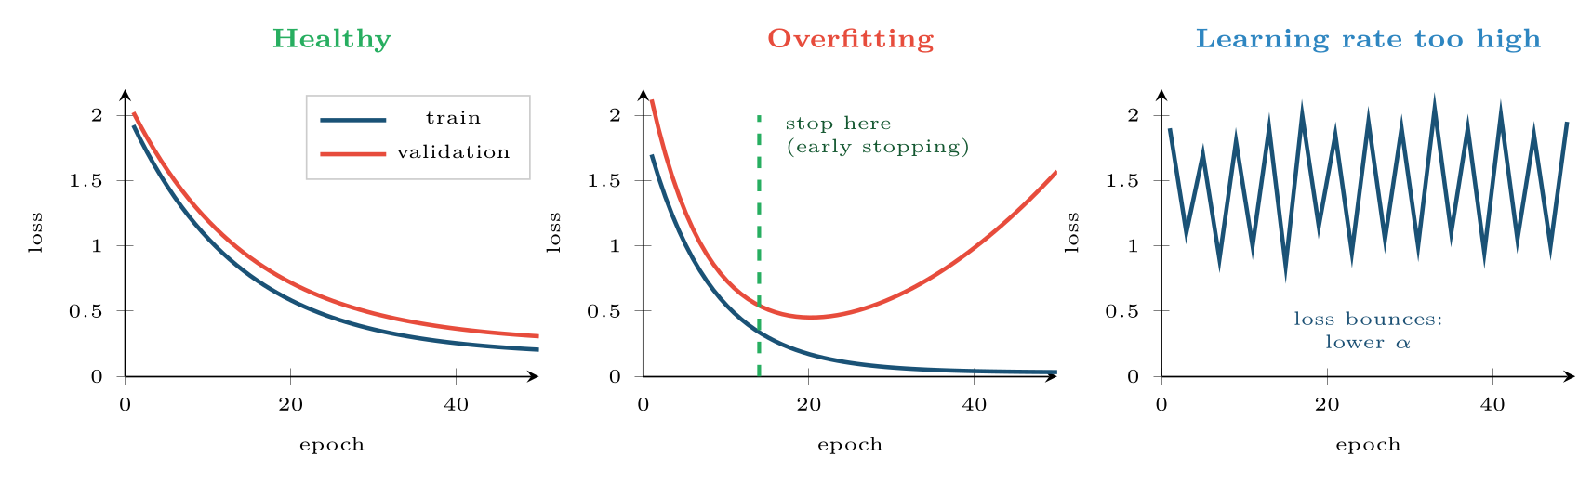
Three training runs
FIGURE 17.4
The gap between the two curves diagnoses overfitting; the shape of the training curve alone diagnoses the learning rate. Plot both curves for every run you do.
Data Science · Chapter 17 · Neural Network Foundations
§17.5 · Handout p. 112 20
Notes:
Figure 17.4 (handout p. 112): Three training runs. The gap between the two curves diagnoses overfitting; the shape of the training curve alone diagnoses the learning rate. Plot both curves for every run you do.

Slide 21

Common pitfalls
COMMON PITFALLS
✕
Forgetting to scale inputs. Neural networks are gradient-based, so unscaled features make the loss surface a narrow ravine and training stalls.
✕
Sigmoid in hidden layers. Its flat tails give near-zero gradients, so early layers stop learning — the vanishing gradient problem. Use ReLU.
✕
Training for a fixed number of epochs. Use early stopping on validation loss.
✕
Reaching for a network on 500 rows of tabular data. Gradient boosting (Chapter 15) will beat it, train in seconds, and be explainable.
Data Science · Chapter 17 · Neural Network Foundations
§17.5 · Handout p. 112 21
Notes:
For each pitfall, ask who has seen it happen. One real story beats five bullets.

Slide 22
When to Use a Neural Network — and When Not To
CONCEPT
Use one for unstructured data — images, audio, text, raw sequences — where features must be learned rather than engineered, and where you have tens of thousands of examples or a pre-trained model to fine-tune.
Do not use one for ordinary tabular data of moderate size. On tabular problems, gradient-boosted trees remain at least competitive and usually better, while training faster and explaining themselves. This is one of the most reliably reproduced results in applied machine learning, and ignoring it costs students a great deal of time.
Data Science · Chapter 17 · Neural Network Foundations
§17.5 · Handout p. 112 22
Notes:
Read the box aloud, then ask for an example from the room before moving on.

Slide 23





Four lenses: Neural Networks
FOUR LENSES
LEARNING ANALYTICS
PROJECT MANAGEMENT
Rarely the right tool for tabular engagement data — a few thousand students and 40 features is gradient-boosting territory.
Almost never appropriate.
INTERNET OF THINGS
CYBERSECURITY
Genuinely useful here, because raw sensor waveforms are unstructured and the fleet generates millions of examples.
Used for malware classification from raw bytes and for sequence models over session logs, where hand-engineered features are brittle against an adapting adversary.
Data Science · Chapter 17 · Neural Network Foundations
Handout p. 114 23
Notes:
The same method, four domains. Each of the next four slides opens one lens in full.

Slide 24

Learning Analytics: Neural Networks
FOUR LENSES
LEARNING ANALYTICS
Project Management
Rarely the right tool for tabular engagement data — a few thousand students and 40 features is gradient-boosting territory. Networks earn their place when the input is unstructured: assessing free-text reflections, or modelling the raw clickstream sequence rather than aggregates (Chapter 19). Whatever the accuracy, an unexplainable model driving interventions on students runs into Chapter 28.
Internet of Things
Cybersecurity
Data Science · Chapter 17 · Neural Network Foundations
Handout p. 114 24
Notes:
Learning Analytics. Rarely the right tool for tabular engagement data — a few thousand students and 40 features is gradient-boosting territory. Networks earn their place when the input is unstructured: assessing free-text reflections, or modelling the raw clickstream sequence rather than aggregates (Chapter 19). Whatever the accuracy, an unexplainable model driving interventions on students runs into Chapter 28.

Slide 25

Project Management: Neural Networks
FOUR LENSES
PROJECT MANAGEMENT
Learning Analytics
Almost never appropriate. With 40 sprints and 67 parameters in even the toy network above, the model has more parameters than observations. The honest answer is a two-feature regression. Knowing when not to use the powerful tool is part of the competence being assessed.
Internet of Things
Cybersecurity
Data Science · Chapter 17 · Neural Network Foundations
Handout p. 114 25
Notes:
Project Management. Almost never appropriate. With 40 sprints and 67 parameters in even the toy network above, the model has more parameters than observations. The honest answer is a two-feature regression. Knowing when not to use the powerful tool is part of the competence being assessed.

Slide 26

Internet of Things: Neural Networks
FOUR LENSES
INTERNET OF THINGS
Learning Analytics
Genuinely useful here, because raw sensor waveforms are unstructured and the fleet generates millions of examples. A small network can also be quantised to run on-device (Chapter 24). Note the constraint that shapes everything: the model must fit in kilobytes and infer in milliseconds, so architecture size is dictated by the hardware, not by accuracy alone.
Project Management
Cybersecurity
Data Science · Chapter 17 · Neural Network Foundations
Handout p. 114 26
Notes:
Internet of Things. Genuinely useful here, because raw sensor waveforms are unstructured and the fleet generates millions of examples. A small network can also be quantised to run on-device (Chapter 24). Note the constraint that shapes everything: the model must fit in kilobytes and infer in milliseconds, so architecture size is dictated by the hardware, not by accuracy alone.

Slide 27

Cybersecurity: Neural Networks
FOUR LENSES
CYBERSECURITY
Learning Analytics
Used for malware classification from raw bytes and for sequence models over session logs, where hand-engineered features are brittle against an adapting adversary. But networks are also uniquely vulnerable: small, deliberately crafted input perturbations can flip a confident prediction. That is adversarial machine learning, and Chapter 26 treats it in full.
Project Management
Internet of Things
Data Science · Chapter 17 · Neural Network Foundations
Handout p. 114 27
Notes:
Cybersecurity. Used for malware classification from raw bytes and for sequence models over session logs, where hand-engineered features are brittle against an adapting adversary. But networks are also uniquely vulnerable: small, deliberately crafted input perturbations can flip a confident prediction. That is adversarial machine learning, and Chapter 26 treats it in full.

Slide 28

Try it yourself: A Network from Scratch, then with a Framework
TRY IT YOURSELF
WHAT YOU WILL DO
1. One neuron, no framework: verify the worked example
2. A tiny two-layer network trained by hand
3. The same thing with a framework, plus early stopping
THIS WEEK'S LAB
WHAT YOU WILL RUN
RUNNABLE COPY
Week 11: Network from scratch; transfer learning
1 listing, 41 lines of Python
code/ch17_network_from_scratch.py
Data Science · Chapter 17 · Neural Network Foundations
§17.5 · Handout p. 112 28
Notes:
Say what the room will have at the end of the lab, then let them start. Circulate rather than lecture.

Slide 29
A Network from Scratch, then with a Framework
LAB · STEP 1 OF 5
Set-up
Python · code/ch17_network_from_scratch.py
1
import numpy as np
Data Science · Chapter 17 · Neural Network Foundations
§17.5 · Handout p. 112 29
Notes:
Step 1: Set-up. Read the code aloud; ask what each line would print before running it.

Slide 30
A Network from Scratch, then with a Framework
LAB · STEP 2 OF 5
One neuron, no framework: verify the worked example
Python · code/ch17_network_from_scratch.py
2
3
4
5
# ---- one neuron, no framework: verify the worked example --------------
x = np.array([0.8, 0.3, 0.5]); w = np.array([1.2, -0.5, 0.9]); b = -0.4
z = w @ x + b
print("z =", z, " relu(z) =", max(0.0, z)) # 0.86, 0.86
Data Science · Chapter 17 · Neural Network Foundations
§17.5 · Handout p. 112 30
Notes:
Step 2: One neuron, no framework: verify the worked example. Read the code aloud; ask what each line would print before running it.

Slide 31
A Network from Scratch, then with a Framework
LAB · STEP 3 OF 5
A tiny two-layer network trained by hand
Python · code/ch17_network_from_scratch.py
6
7
8
9
10
11
12
13
14
15
16
17
18
19
20
21
22
23
24
# ---- a tiny two-layer network trained by hand ------------------------
rng = np.random.default_rng(0)
X = rng.normal(size=(500, 3))
y = ((X[:, 0] + X[:, 2] - X[:, 1]) > 0).astype(float).reshape(-1, 1)
W1, b1 = rng.normal(size=(3, 8))*0.5, np.zeros((1, 8))
W2, b2 = rng.normal(size=(8, 1))*0.5, np.zeros((1, 1))
lr = 0.1
for epoch in range(400):
h = np.maximum(0, X @ W1 + b1) # forward: ReLU hidden
p = 1/(1 + np.exp(-(h @ W2 + b2))) # forward: sigmoid out
loss = -np.mean(y*np.log(p+1e-9) + (1-y)*np.log(1-p+1e-9))
dz2 = (p - y) / len(X) # backprop
dW2, db2 = h.T @ dz2, dz2.sum(0, keepdims=True)
dh = dz2 @ W2.T
dz1 = dh * (h > 0) # ReLU derivative
dW1, db1 = X.T @ dz1, dz1.sum(0, keepdims=True)
Data Science · Chapter 17 · Neural Network Foundations
§17.5 · Handout p. 112 31
Notes:
Step 3: A tiny two-layer network trained by hand. Read the code aloud; ask what each line would print before running it.

Slide 32
A Network from Scratch, then with a Framework
LAB · STEP 4 OF 5
A tiny two-layer network trained by hand (continued)
Python · code/ch17_network_from_scratch.py
25
26
27
W1 -= lr*dW1; b1 -= lr*db1; W2 -= lr*dW2; b2 -= lr*db2 # update
if epoch % 100 == 0:
print(f"epoch {epoch:3d} loss {loss:.4f}")
Data Science · Chapter 17 · Neural Network Foundations
§17.5 · Handout p. 112 32
Notes:
Step 4: A tiny two-layer network trained by hand (continued). Read the code aloud; ask what each line would print before running it.

Slide 33
A Network from Scratch, then with a Framework
LAB · STEP 5 OF 5
The same thing with a framework, plus early stopping
Python · code/ch17_network_from_scratch.py
28
29
30
31
32
33
34
35
36
37
# ---- the same thing with a framework, plus early stopping ------------
# from tensorflow import keras
# model = keras.Sequential([
# keras.layers.Dense(32, activation="relu", input_shape=(3,)),
# keras.layers.Dropout(0.3),
# keras.layers.Dense(1, activation="sigmoid")])
# model.compile(optimizer="adam", loss="binary_crossentropy", metrics=["AUC"])
# model.fit(X, y, epochs=200, validation_split=0.2,
# callbacks=[keras.callbacks.EarlyStopping(patience=10,
# restore_best_weights=True)])
Data Science · Chapter 17 · Neural Network Foundations
§17.5 · Handout p. 112 33
Notes:
Step 5: The same thing with a framework, plus early stopping. Read the code aloud; ask what each line would print before running it.

Slide 34
What the lab shows
TRY IT YOURSELF
Experiment: set lr = 5.0 and watch the loss bounce, reproducing the right-hand panel of Figure 17.4.
Data Science · Chapter 17 · Neural Network Foundations
§17.5 · Handout p. 112 34
Notes:
Read the box aloud, then ask for an example from the room before moving on.

Slide 35

A neuron has w = [0.5, −1.0], b = 0.3, input x = [2.0, 1.0], ReLU activation. Compute its output.
CHECKPOINT 1 OF 3
Discuss with the person next to you, then advance.
Data Science · Chapter 17 · Neural Network Foundations
Handout p. 114 · answers in Appendix D 35
Notes:
Ask the room. Do not advance until someone commits to an answer.

Slide 36

A neuron has w = [0.5, −1.0], b = 0.3, input x = [2.0, 1.0], ReLU activation. Compute its output.
CHECKPOINT 1 OF 3 · ANSWER
z = (0.5)(2.0) + (−1.0)(1.0) + 0.3 = 1.0 − 1.0 + 0.3 = 0.3. ReLU(0.3) = 0.3.
Data Science · Chapter 17 · Neural Network Foundations
Handout p. 114 · answers in Appendix D 36
Notes:
Answer (Appendix D): z = (0.5)(2.0) + (−1.0)(1.0) + 0.3 = 1.0 − 1.0 + 0.3 = 0.3. ReLU(0.3) = 0.3.

Slide 37
Why does a network of purely linear layers gain nothing from depth?
CHECKPOINT 2 OF 3
Discuss with the person next to you, then advance.
Data Science · Chapter 17 · Neural Network Foundations
Handout p. 114 · answers in Appendix D 37
Notes:
Ask the room. Do not advance until someone commits to an answer.

Slide 38
Why does a network of purely linear layers gain nothing from depth?
CHECKPOINT 2 OF 3 · ANSWER
Because the composition of linear functions is linear: W₂(W₁x) = (W₂W₁)x. A hundred linear layers compute what one linear layer computes.
Data Science · Chapter 17 · Neural Network Foundations
Handout p. 114 · answers in Appendix D 38
Notes:
Answer (Appendix D): Because the composition of linear functions is linear: W2(W1x) = (W2W1)x. A hundred linear layers compute what one linear layer computes.

Slide 39
Training loss keeps falling while validation loss has been rising for 12 epochs. What is happening and what should you do?
CHECKPOINT 3 OF 3
Discuss with the person next to you, then advance.
Data Science · Chapter 17 · Neural Network Foundations
Handout p. 114 · answers in Appendix D 39
Notes:
Ask the room. Do not advance until someone commits to an answer.

Slide 40
Training loss keeps falling while validation loss has been rising for 12 epochs. What is happening and what should you do?
CHECKPOINT 3 OF 3 · ANSWER
Overfitting. Stop training and restore the weights from the epoch with the lowest validation loss — which is exactly what early stopping automates.
Data Science · Chapter 17 · Neural Network Foundations
Handout p. 114 · answers in Appendix D 40
Notes:
Answer (Appendix D): Overfitting. Stop training and restore the weights from the epoch with the lowest validation loss — which is exactly what early stopping automates.

Slide 41

What to take away
CHAPTER SUMMARY
1
A neuron computes f(Σ w_{j} x_{j} + b). With a sigmoid it is logistic regression; depth is what makes it more.
2
Without non-linear activations, stacked layers collapse to a single linear layer.
3
ReLU for hidden layers; sigmoid, softmax or linear at the output depending on the task.
4
Training is forward pass → loss → backpropagation → update, repeated per batch.
5
The learning rate is the hyperparameter that most often decides success. Use early stopping instead of a fixed epoch count.
6
Scale inputs. And for moderate tabular data, prefer gradient boosting — knowing when not to use a network is part of the skill.
Data Science · Chapter 17 · Neural Network Foundations
Handout p. 114 41
Notes:
Ask the room to say each takeaway before you reveal it.

Slide 42

Quick check 1 of 2
REVIEW · MULTIPLE CHOICE
The standard activation for hidden layers is:
A
sigmoid
B
softmax
C
ReLU
D
linear
Data Science · Chapter 17 · Neural Network Foundations
Handout p. 114 42
Notes:
Take a show of hands for each option before discussing. (The handout does not print MCQ answers.)

Slide 43
Quick check 2 of 2
REVIEW · MULTIPLE CHOICE
Backpropagation computes:
the gradient of the loss with respect to each weight
A
the loss
B
C
the forward predictions
D
the learning rate
Data Science · Chapter 17 · Neural Network Foundations
Handout p. 114 43
Notes:
Take a show of hands for each option before discussing. (The handout does not print MCQ answers.)

Slide 44
For your notebook
REVIEW QUESTIONS
SHORT
Explain the vanishing gradient problem and why ReLU mitigates it.
SHORT
Define an epoch and a batch, and explain how they relate.
SHORT
Give two reasons to prefer gradient boosting over a neural network on a 5,000-row tabular dataset.
APPLIED
A network has 10 inputs, one hidden layer of 20 neurons, and 3 softmax outputs. Count the learnable parameters, showing your working.
APPLIED
Your training loss oscillates wildly and never settles. List three candidate causes in the order you would investigate them, with the check you would run for each.
Data Science · Chapter 17 · Neural Network Foundations
Handout p. 114 44
Notes:
Set these for independent study. Model answers are not printed in the handout.

Slide 45
End of Chapter 17
17
NEXT
READ
Chapter 18 — Deep Architectures
Handout Chapter 17, pages 109–114
THIS WEEK'S LAB
Network from scratch; transfer learning
Data Science · Chapter 17 · Neural Network Foundations
45
Notes:
Close. NEXT: Chapter 18 — Deep Architectures. READ: Handout Chapter 17, pages 109–114. THIS WEEK'S LAB: Network from scratch; transfer learning.

